Slide 1
Photo Tourism
With Sean & Matt

Slide 2
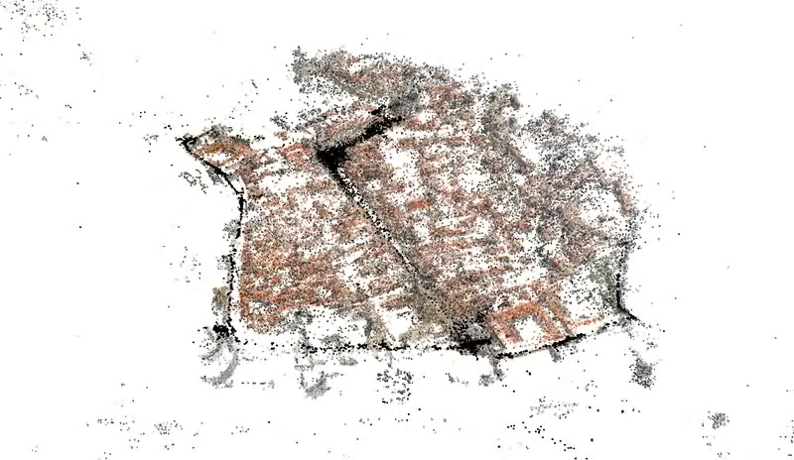
Building Dubrovnik In a Day

Slide 3
Building Dubrovnik In a Day
57,845 Images
3,485,717 Points
5Hrs (Matching) + 17.5Hrs (Reconstruction)
352 Computer Cores
Equates to ~10 days on 8x Amazon Cluster Compute Instances
@ $2.40 per hour = $576
Our Project: ~2 orders of magnitude smaller

Slide 4
Structure from Motion for Unordered Image Collections
Software written by Noah Snavely
Written in C and C++
Version 0.4
Released April 10, 2010
Found at: phototour.cs.washington.edu

Slide 5

Stony Brook University

Slide 6
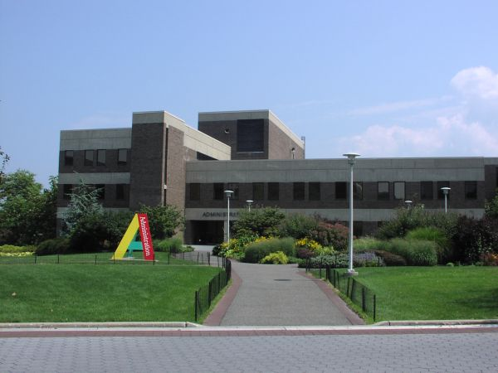

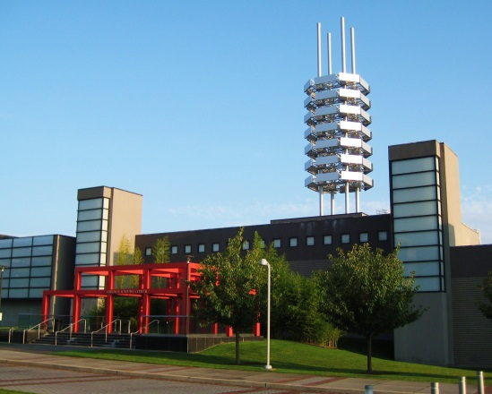
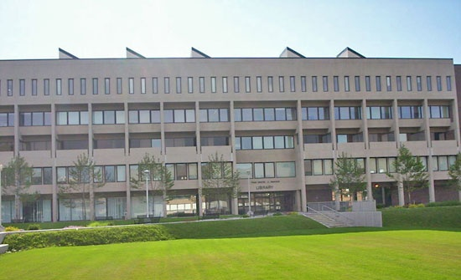
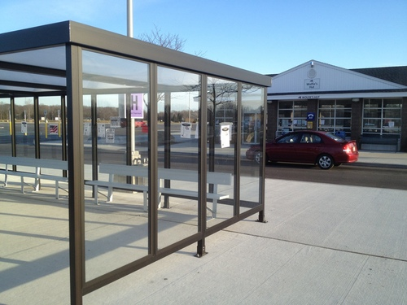
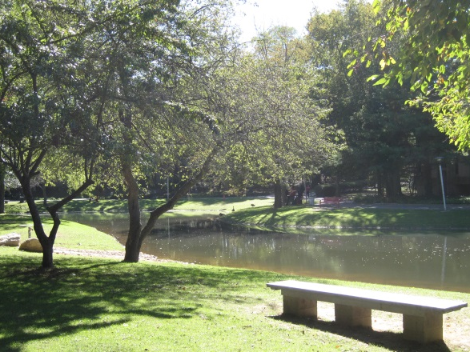
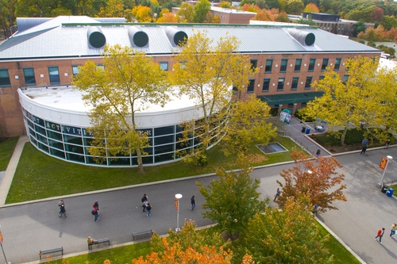
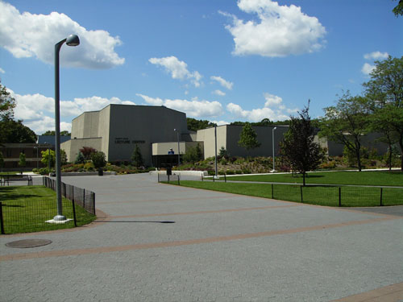
Stony Brook Virtual Tour

Slide 7
Image Sources
Own photos
(Long Day & Large Memory Card)
Flicker
Social Media Sites
Crowd Sourcing
SBUPhoto@Gmail.com

Slide 8
Credits
Noah Snavely, Steven M. Seitz, Richard Szeliski. Photo Tourism: Exploring image collections in 3D. ACM Transactions on Graphics (Proceedings of SIGGRAPH 2006), 2006.
Noah Snavely, Steven M. Seitz, Richard Szeliski. Modeling the World from Internet Photo Collections. International Journal of Computer Vision, 2007.

Slide 9
Tourism Types
Inward Tourism
Outward Tourism
A Single object
Photographed inward about an object
Examples
Fountains
Buildings
Architecture
Many Objects
Photographing outward around a point
Examples
Town Squares
Rooms / Halls
Panaramic

